Slide 1
Research Plan: The Transmission Expansion Planning Problem under the zero-carbon emission context
Erik F. Alvarez
Supervisors: Dr. Andrés Ramos Galán and Dr. Luis Olmos Camacho

Slide 2
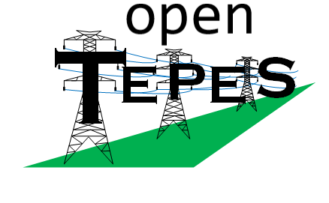


Reduction techniques of the problem size
Transmission grid modelling
Temporal reduction
Representative stage (periods) with chronological interdependency
Search-space reduction
Portfolio projects (decision variable clustering) based on game theory
AC-OPF within the TEP problem
An improved linear AC-OPF model
Based on the branch flow model
A SOCP AC-OPF model
Based on the Line-Wise model
It allows us:
Investment in Reactive power compensation
To verify the accuracy and feasibility of the solution obtained
Central and Local Flexibility
Model
Central flexibility
Management of hydro reservoirs, PSH, batteries, etc.
Local flexibility
Demand-side management
Bi-level model considering distribution grid and microgrids as well as local flexibility schemes.
Multi-stage transmission expansion planning
Hourly resolution
Storage management and investment

Slide 3
Temporal reduction
What data to use for it?
Ex-ante or ex-post?
correlations?
Clustering
Heuristic
Optimization
Relation between periods
Transition matrices
Robustness of the clustering
Multiple Scenarios
Multiple periods
Stability of the representative periods
Stochastic multi-period transmission expansion planning with suitable representative periods

Slide 4
Joint Research Work:
Introducing Learning Algorithms within an Operational State Aggregation Method for Power System Planning

Slide 5
Problem Definition
To solve our problems:
Kristof: GEP with Representative Areas (Geographical aggregation considering weather area)
Erik: TEP with Representative Weeks of 24 hours
Considering AC-OPF (4-6 times of the TEP with DC-OPF)
*ESOM: Energy System Optimization Model
*GEP: Generation & Storage Expansion Planning
*TEP: Transmission Expansion Planning
*TSA: Time Series Aggregation

Slide 6
State-of-the-art
The main feature of the paper:
[1], is related to compare TSA methods and GEP formulations which allow for long-term storage for the first time in an investment setting.
[3], is related to the unification of methods by Hilbers et al. and Teichgraeber et al.– which use operational variables in models without storage – with that of Kotzur et al.– which allow chronology-preserving aggregation for storage technologies.
[6], is related to the unification of the a priori and posteriori schemes.
[7], is related to consider the a posteriori scheme which uses the operation and investment cost.
Gaps:
A posteriori scheme or ex-port or Cost/Benefit oriented approach
Ordering and inter-periods links
Years data
Dynamic planning
Stochastic
*ESOM: Energy System Optimization Model
*GEP: Generation & Storage Expansion Planning
*TEP: Transmission Expansion Planning
*TSA: Time Series Aggregation
Notes:
[1] Gonzato, Sebastian, Kenneth Bruninx, and Erik Delarue. "Long term storage in generation expansion planning models with a reduced temporal scope." Applied Energy 298 (2021): 117168.
[2] Pfenninger, Stefan. "Dealing with multiple decades of hourly wind and PV time series in energy models: A comparison of methods to reduce time resolution and the planning implications of inter-annual variability." Applied energy 197 (2017): 1-13.
[3] Hilbers, Adriaan P., David J. Brayshaw, and Axel Gandy. "Reducing climate risk in energy system planning: a posteriori time series aggregation for models with storage." Applied Energy 334 (2023): 120624.
[4] Kittel, Martin, Hannes Hobbie, and Constantin Dierstein. "Temporal aggregation of time series to identify typical hourly electricity system states: A systematic assessment of relevant cluster algorithms." Energy 247 (2022): 123458.
[5] Merrick, James H., John ET Bistline, and Geoffrey J. Blanford. "On representation of energy storage in electricity planning models." arXiv preprint arXiv:2105.03707 (2021).
[6] Zhang, Yuheng, et al. "A Model-Adaptive Clustering-Based Time Aggregation Method for Low-Carbon Energy System Optimization." IEEE Transactions on Sustainable Energy 14.1 (2022): 55-64.
[7] Sun, Mingyang, et al. "Data-driven representative day selection for investment decisions: A cost-oriented approach." IEEE Transactions on Power Systems 34.4 (2019): 2925-2936.
[8] Fazlollahi, Samira, et al. "Multi-objectives, multi-period optimization of district energy systems: I. Selection of typical operating periods." Computers & Chemical Engineering 65 (2014): 54-66.

Slide 7
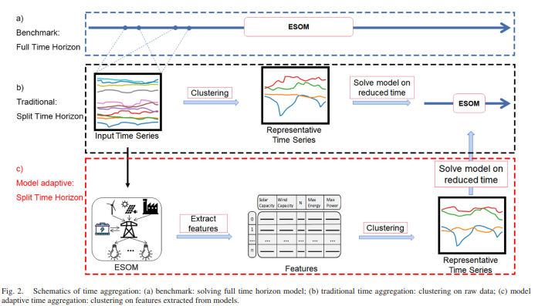
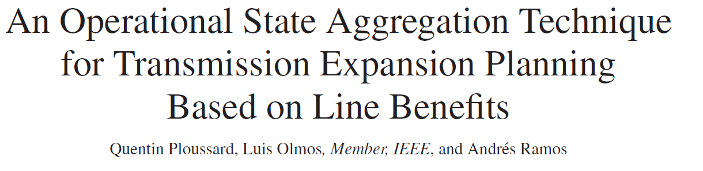
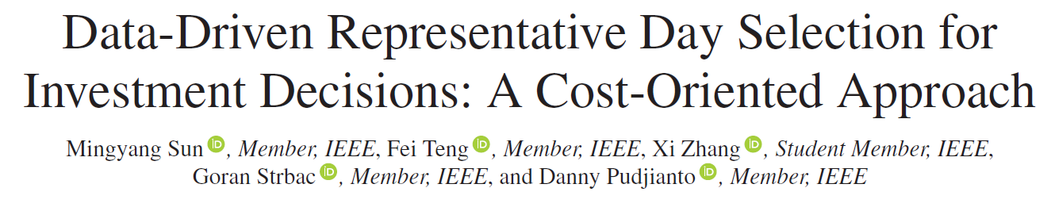
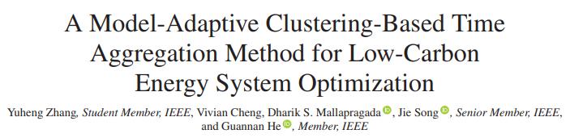
2017
2019
2023

Slide 8
Keys & Gaps
Keys:
Do we need to perform the problem size reduction? Yes! about 35 times more efficient – according to Ploussard, Q., et al.
Ex-ante or ex-post? Ex-post! We got rich data from models
Time consumption of the method? 60 min without considering the execution of the relaxed model and only 24 nodes!
Thus, We:
Use of representative days/hours/weeks or non-homogenous sets of hours/days to reduce computational complexity of planning models
For the selection of these representatives, clustering is usually performed over a large set of multi-dimensional input data.
Use a relaxed version of the planning model (i.e., TEP with continuous variables) in the “a posteriori” scheme
The relaxed version is usually executed per hour, day, or week but also for all the year in a deterministic planning approach.
Problems & Gaps:
Considering a huge amounts of weather data, solving the relaxed model for all possible input days might still be computationally demanding
Using a learning algorithm to approximate the outputs of the relaxed model
Accuracy
Scalability

Slide 9
Gaps
From Literature:
Do we need to perform the problem size reduction? Yes! about 35 times more efficient – according to Ploussard, Q., et al.
Ex-ante or ex-post? Ex-post! We got rich data from models
Time consumption of the method? 60 min without considering the execution of the relaxed model and only 24 nodes!
Thus, We:
Use of representative days/hours/weeks or non-homogenous sets of hours/days to reduce computational complexity of planning models
For the selection of these representatives, clustering is usually performed over a large set of multi-dimensional input data.
Use a relaxed version of the planning model (i.e., TEP with continuous variables) in the “a posteriori” scheme
The relaxed version is usually executed per hour, day, or week but also for all the year in a deterministic planning approach.
Problems & Gaps:
Considering a huge amounts of weather data, solving the relaxed model for all possible input days might still be computationally demanding
Using a learning algorithm to approximate the outputs of the relaxed model
Accuracy
Scalability

Slide 10
Summary
GAPS
From Literature:
Do we need to perform the problem size reduction?
Yes! about 35 times more efficient – according to Ploussard, Q., et al.
Ex-ante or ex-post?
Ex-post! We got rich data from models
Time consumption of the method?
60 min without considering the execution of the relaxed model and only 24 nodes!
Consider a huge amounts of weather data (scenarios or years)
Use of learning algorithms to replace part or all the process of the determination of representatives.
Increase accuracy and scalability

Slide 11
Proposal: Part 1 Enhancing parts of the Operational State Aggregation Method using Learning Algorithms
Relaxed ESOM
Extract features
Clustering Method
Representative hours, days or system states
ESOM
Relaxed ESOM
Extract features
Clustering Method
Representative hours, days or system states
ESOM
Current proposal
Potential extension
Greedy ambition
Learning-assisted Optimization
*ESOM: Energy System Optimization Model
*GEP: Generation & Storage Expansion Planning
*TEP: Transmission Expansion Planning

Slide 12
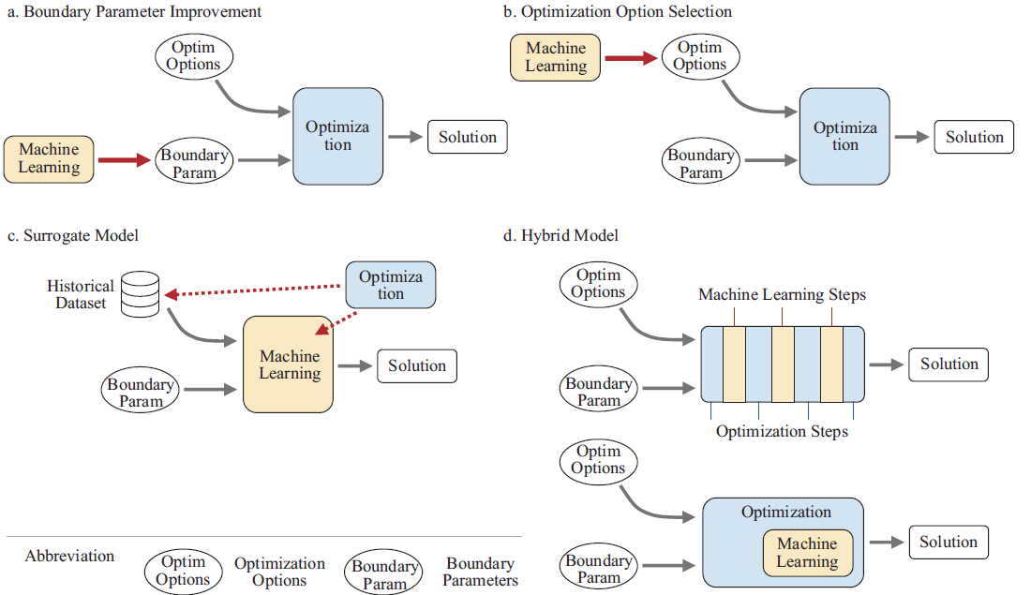
Learning-assisted optimization approaches
Boundary Parameter Improvement (estimation of parameters in openTEPES):
Improve the estimation of these parameters to get a more accurate feasible regions
Deep learning approach
Multivariate clustering technique + recurrent neural network
Optimization Option Selection (initial values of variables in openTEPES):
Boost the optimization performance by selecting better options (estimation) (e.g., initial values, on/off status)
Neural Networks
Surrogate Model
Replace optimization or control models
Reinforcement learning
Markov decisions
Deep reinforcement learning
Hybrid Model
Combine machine learning approaches and optimization model to boost the overall performance
Iterative structure
Coupled structure that embeds a learning models
Neural networks
[1] Ruan, Guangchun, et al. "Review of learning-assisted power system optimization." CSEE Journal of Power and Energy Systems 7.2 (2020): 221-231.

Slide 13
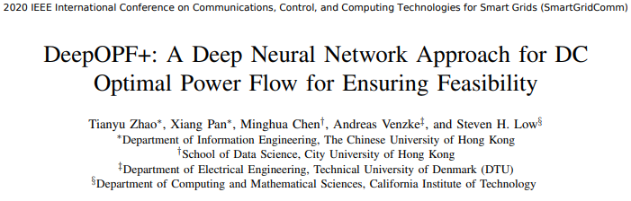
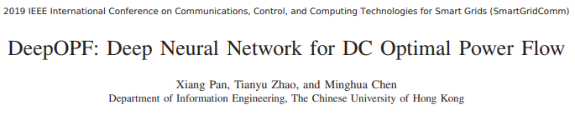
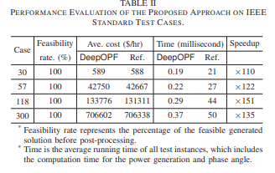
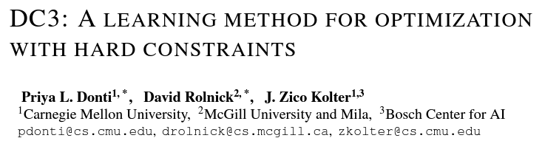
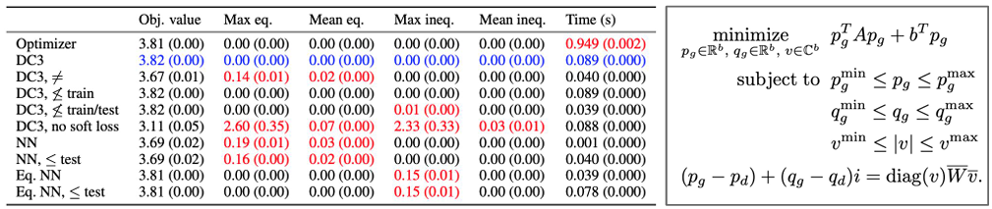
Surrogate Models -> Hybrid Models

Slide 14
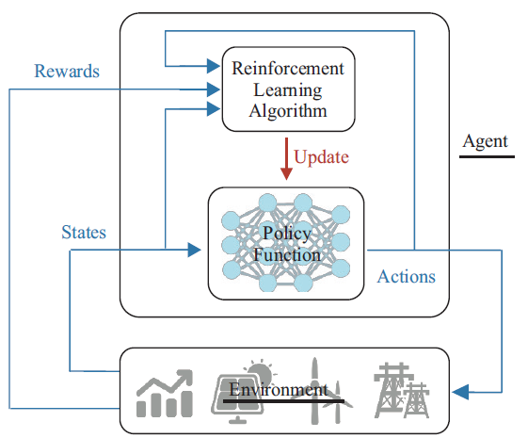
Proposal: Learning approaches
Deep learning:
It is a subfield of machine learning that uses neural networks with many layers to learn hierarchical representations of data. Deep learning has revolutionized many areas of AI, including computer vision, natural language processing, and speech recognition.
Pros:
Deep learning can learn complex patterns in data that are difficult to capture with traditional machine learning models.
It can handle high-dimensional data.
Cons:
Deep learning models can be computationally expensive to train.
They require large amounts of data to achieve good performance.
They can be prone to overfitting.
Reinforcement learning:
It is a type of machine learning that involves an agent learning to make decisions by interacting with an environment. The agent receives rewards or penalties based on its actions, and its goal is to maximize its cumulative reward over time.
Pros:
Reinforcement learning can be used for tasks where there is no labeled training data.
It can learn to make decisions in complex environments with long-term dependencies.
Cons:
Reinforcement learning can be computationally expensive to train.
It requires careful tuning of hyperparameters and reward functions.
It can be prone to instability during training.
Deep reinforcement learning:
It combines reinforcement learning with deep learning, allowing the agent to learn complex representations of its environment. Deep reinforcement learning has achieved state-of-the-art performance in many domains, including playing video games and controlling robots.
Pros:
Deep reinforcement learning can learn complex strategies in environments with high-dimensional state spaces.
It can learn from raw sensory input, without the need for hand-engineered features.
Cons:
Deep reinforcement learning can be computationally expensive to train.
It requires careful tuning of hyperparameters and reward functions.
It can be prone to instability during training, especially when using function approximators like neural networks.
[1] Ruan, Guangchun, et al. "Review of learning-assisted power system optimization." CSEE Journal of Power and Energy Systems 7.2 (2020): 221-231.

Slide 15
Neural Networks
Neural network:
It can be used for a variety of tasks, such as image classification, natural language processing, and time series prediction.
Neural networks are used to approximate the optimal action-value or state-value function, which determines the expected reward that the agent will receive for each action in a given state.
Pros:
Neural networks can learn complex nonlinear relationships between inputs and outputs.
They can be used for a wide range of applications.
They can handle high-dimensional data.
Cons:
Neural networks can be computationally expensive to train.
They require large amounts of data to achieve good performance.
They can be prone to overfitting.
Multi-layer perceptron (MLP):
A feedforward neural network with multiple layers of fully connected neurons. MLPs are often used for function approximation in reinforcement learning.
Convolutional neural network (CNN):
A neural network designed for processing inputs that have a grid-like topology, such as images. CNNs are often used for visual perception tasks in reinforcement learning.
Recurrent neural network (RNN):
A neural network with feedback connections that allow it to process sequences of inputs. RNNs are often used for tasks that involve temporal dependencies in reinforcement learning.
Long Short-Term Memory (LSTM):
A type of RNN that is designed to capture long-term dependencies in sequential data. LSTMs are often used for tasks that require memory in reinforcement learning.
Transformer Network (TN):
The Transformer Neural Network is a novel architecture that aims to solve sequence-to-sequence tasks while handling long-range dependencies with ease. It was proposed in the paper “Attention Is All You Need” 2017.
[1] Chen, Xin, et al. "Reinforcement learning for selective key applications in power systems: Recent advances and future challenges." IEEE Transactions on Smart Grid (2022).

Slide 16
Research Plan

Slide 17

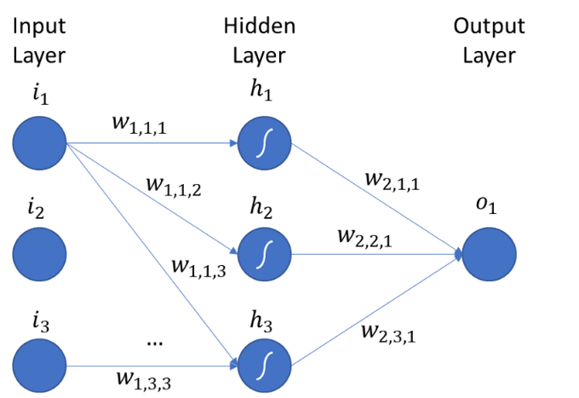

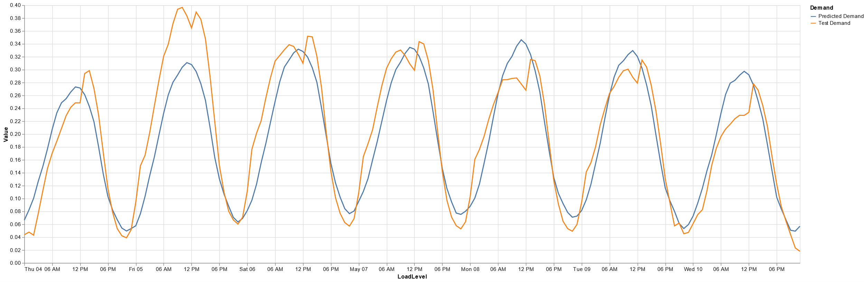
Understanding Neural Networks: Forecasting example

Slide 18
Understanding Neural Networks: Observations
Tests:
Optimal number of neurons
Regularization techniques (Hyperparameters)
Dropout
Weight Decay
Observations
Considering multiple layers, lead us to the usage of a significant number of neurons.
A randomly dropping out with a probability between 10% and 30% leads us to a best performance on the validation set.
A small penalty term (0.0001-0.001) in weight decay regularization also leads us to a best performance.
A common practice is to use a grid search or random search to explore a range of hyperparameter values and select the one that gives the best performance on a validation set.

Slide 19
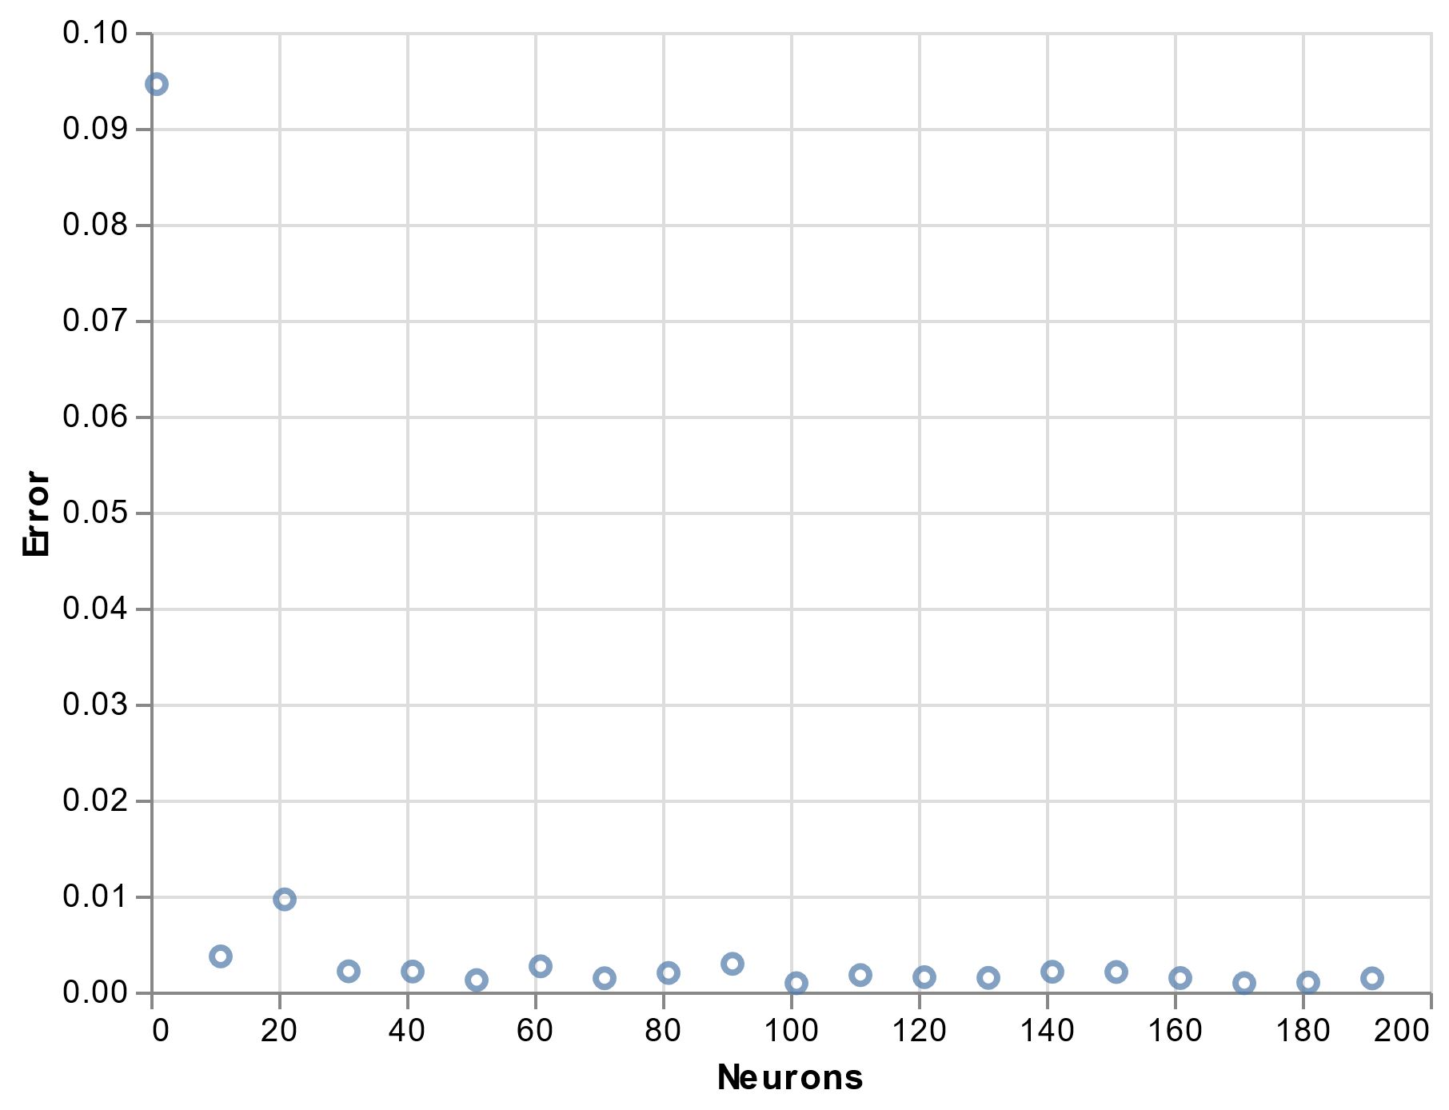
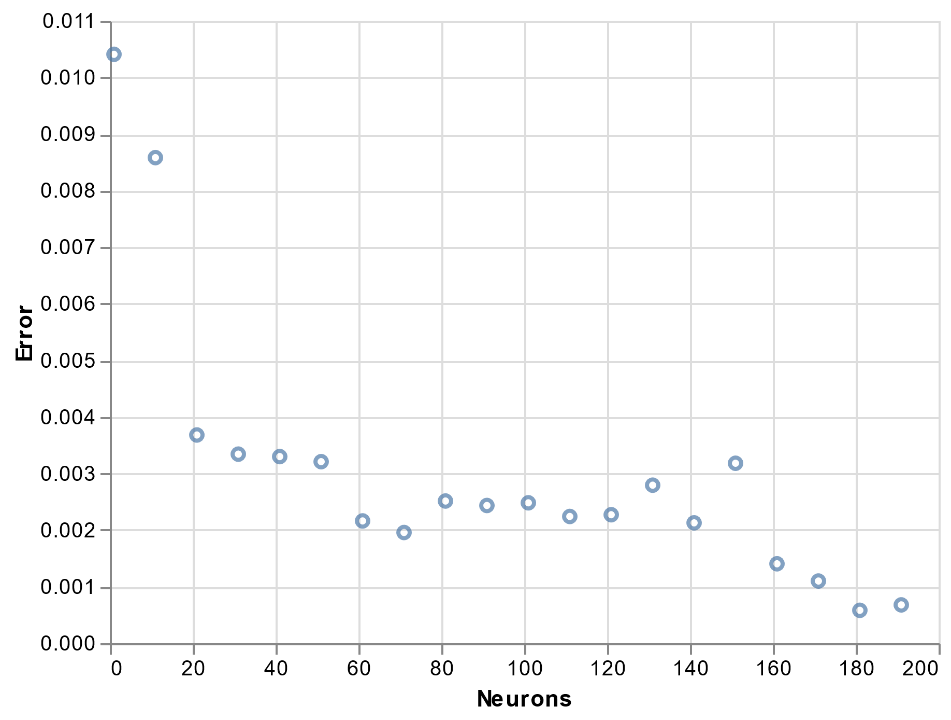
Understanding Neural Networks: Optimal Number of Neurons
NN: 1 hidden layer, 100 epochs
NN: 2 hidden layer, 100 epochs

Slide 20
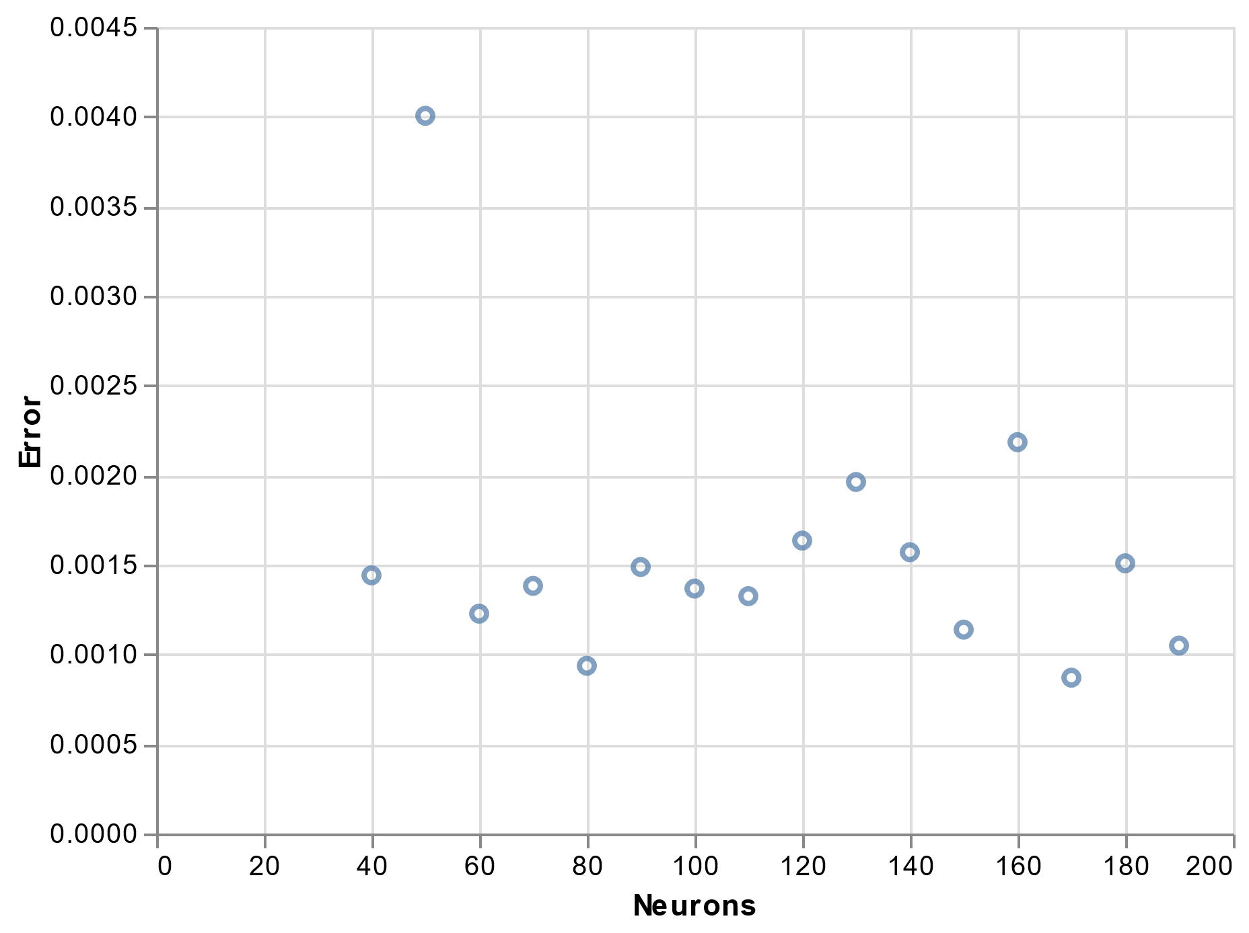
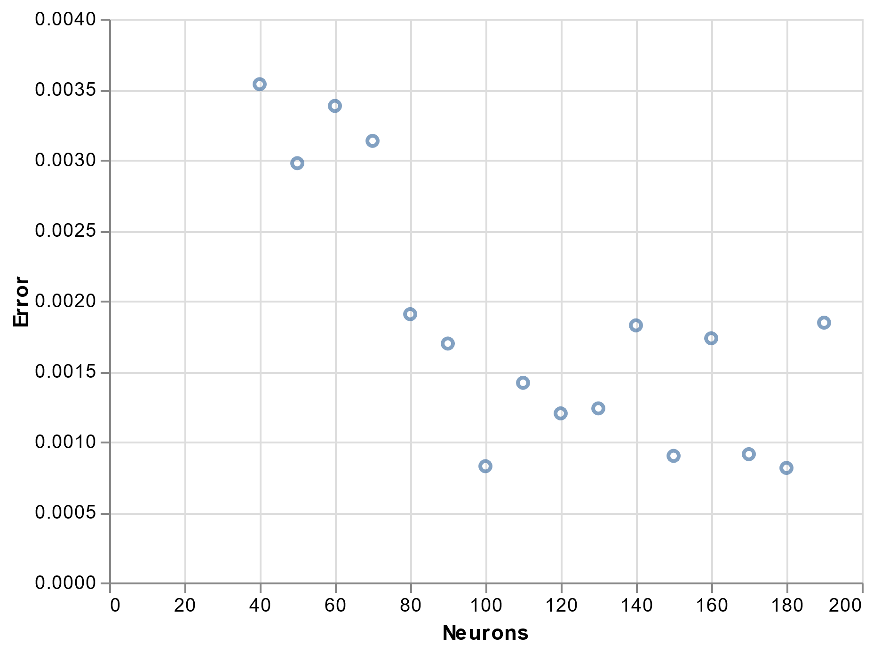
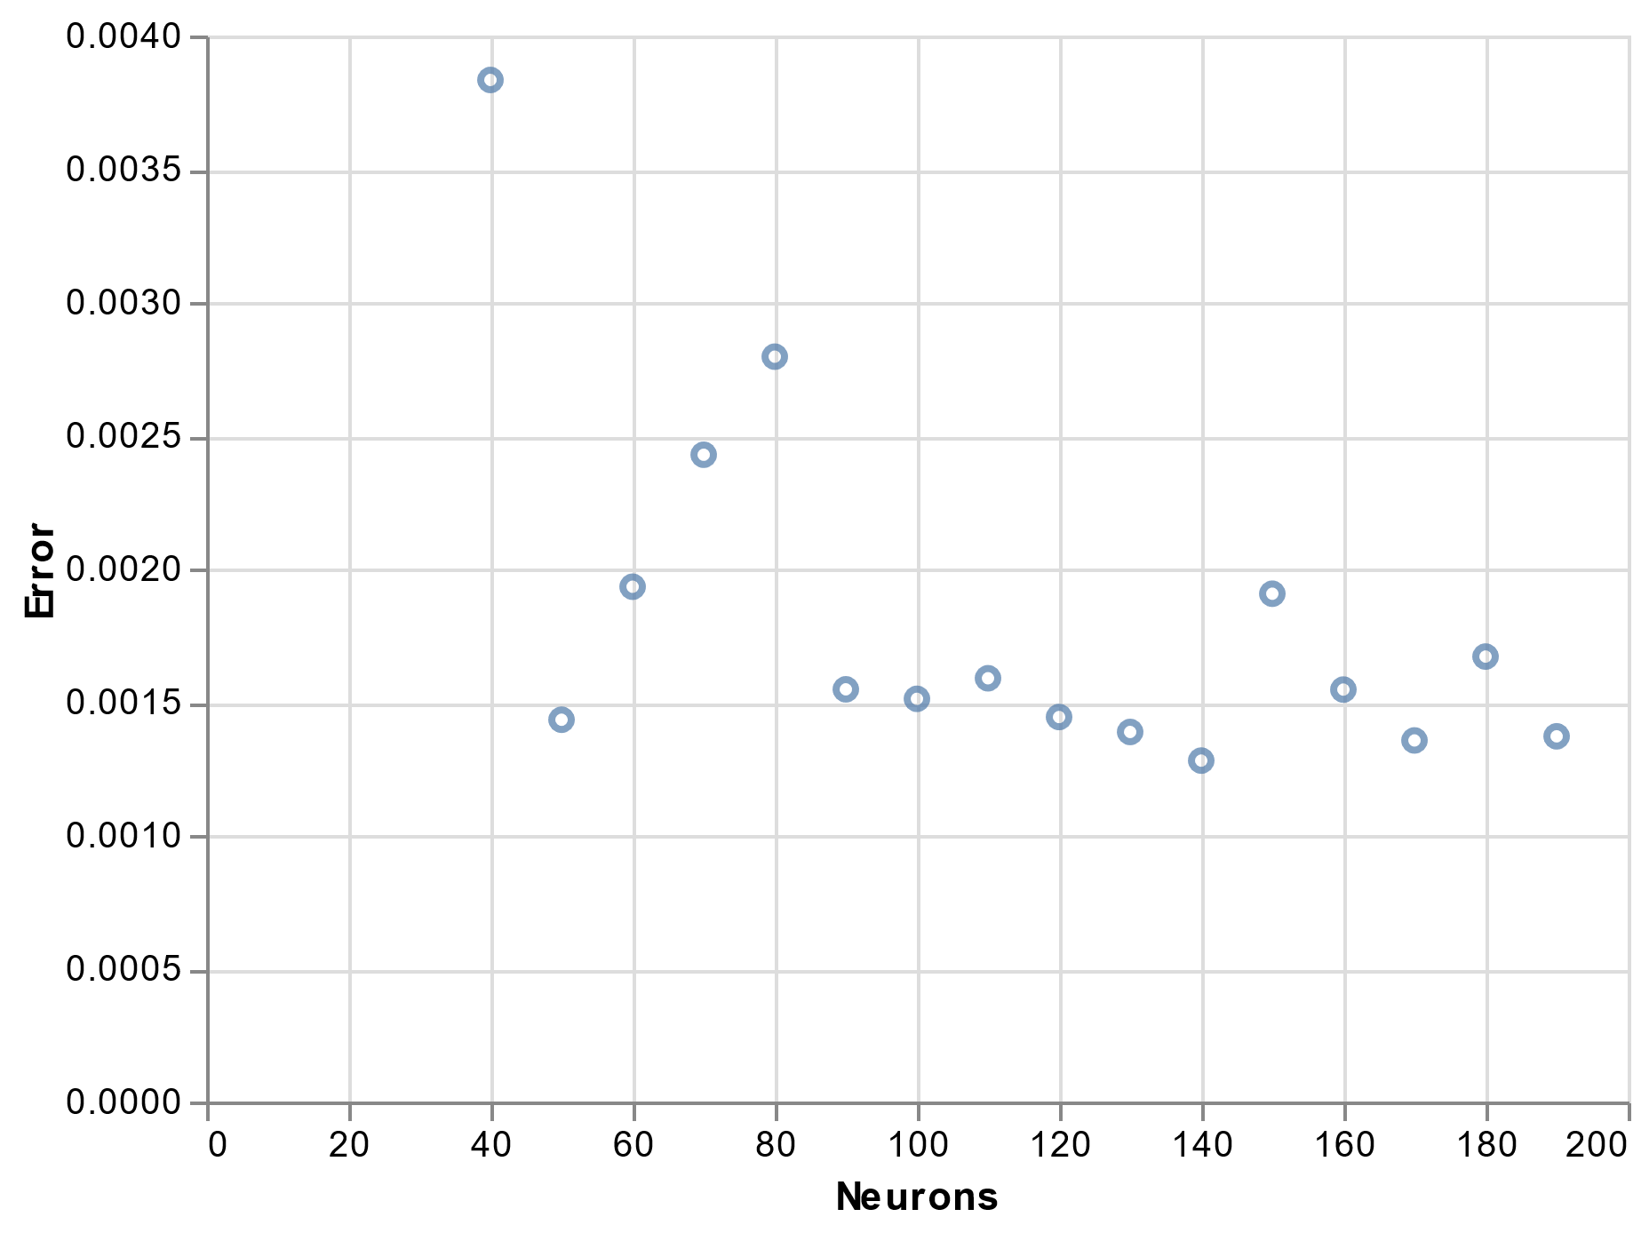
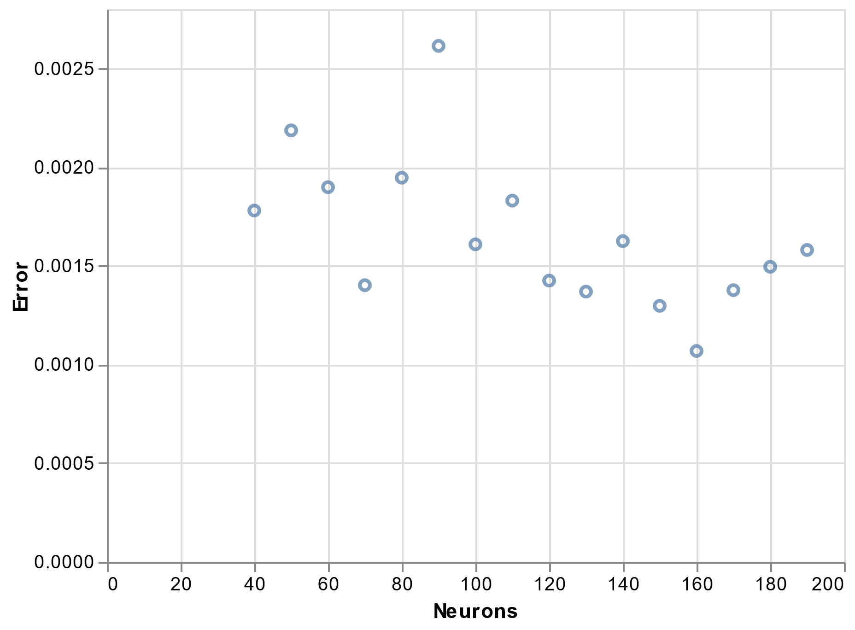
Understanding Neural Networks: Regularization technique - Dropout
Dropout is a regularization technique used to prevent overfitting in neural networks. It works by randomly dropping out with a certain probability (setting to zero) some neurons during training, which forces the remaining neurons to learn more robust features.
NN: 1 hidden layer, 100 epochs, Dropout: 00%
Dropout: 10%
Dropout: 20%
Dropout: 40%
Dropout: 60%

Slide 21
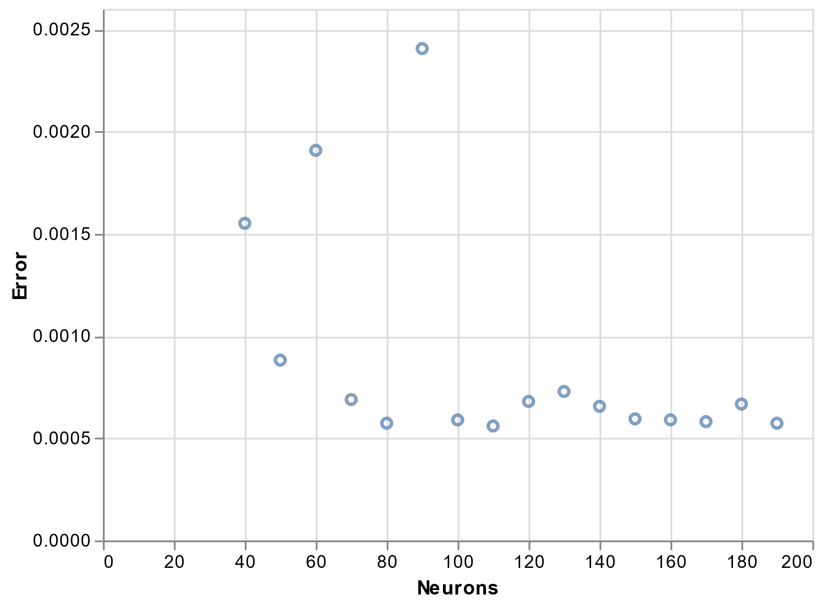
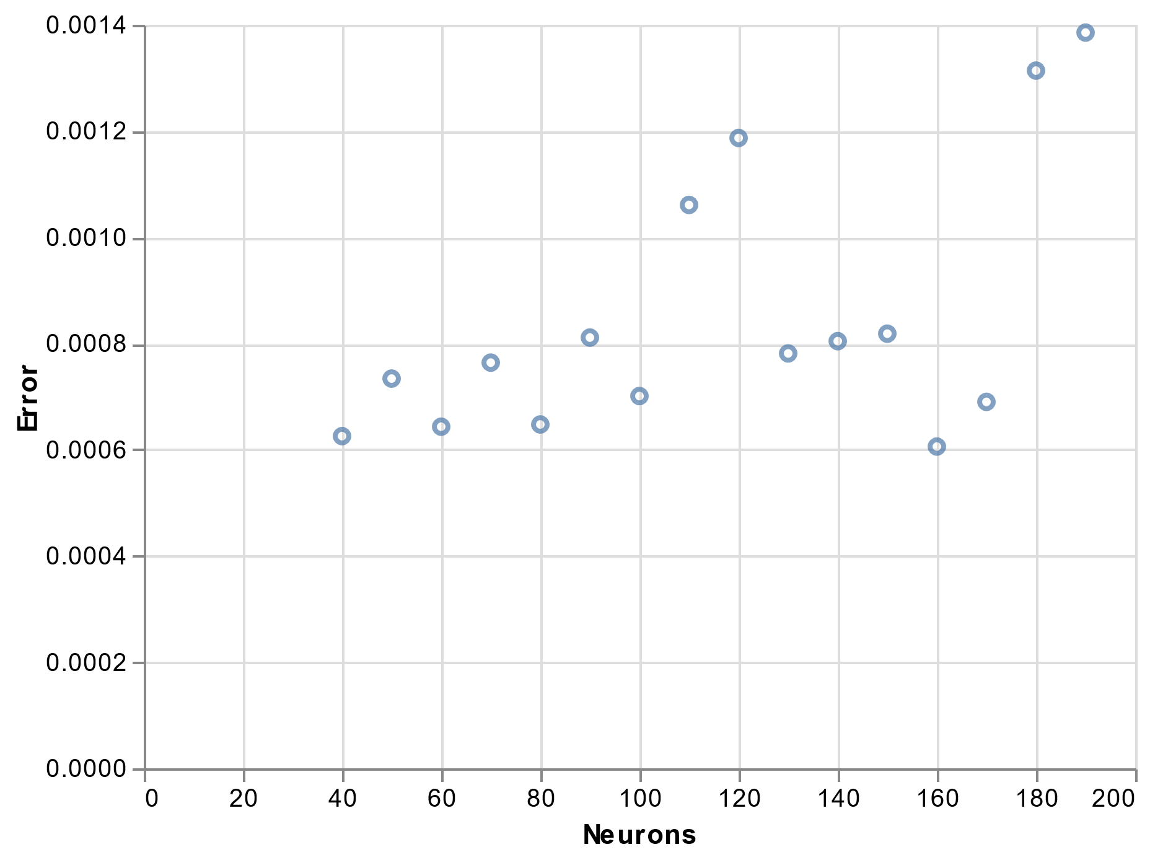
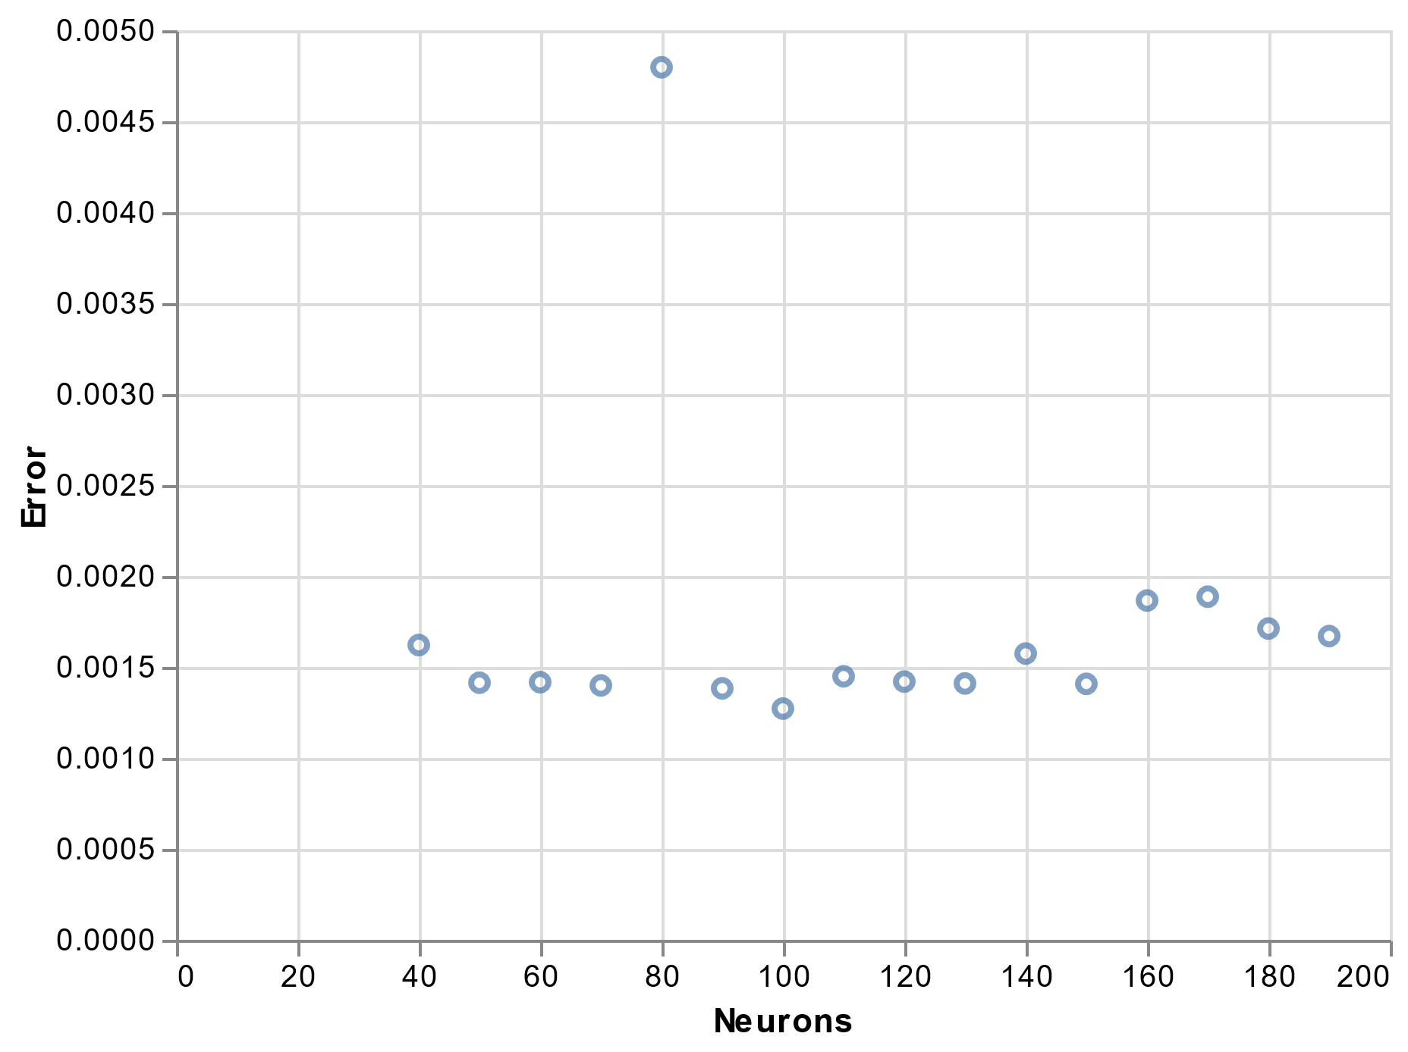
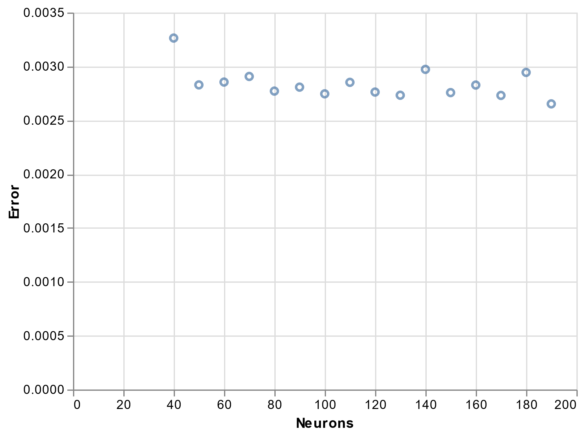
Understanding Neural Networks: Regularization technique - Weight Decay
Weight decay is a regularization technique used to prevent overfitting in neural networks by adding a penalty term to the loss function that encourages the weights to be small.
NN: 1 hidden layer, 100 epochs, no weight decay
Weight decay: 0.0001
Weight decay: 0.001
Weight decay: 0.01
Weight decay: 0.1

Slide 22
Understanding Neural Networks: Observations
Considering multiple layers, lead us to the usage of a significant number of neurons.
A randomly dropping out with a probability between 10% and 30% leads us to a best performance on the validation set.
A small penalty term (0.0001-0.001) in weight decay regularization also leads us to a best performance.
A common practice is to use a grid search or random search to explore a range of hyperparameter values and select the one that gives the best performance on a validation set.
ToDo:
To explore two more regularization techniques:
L1 and L2 regularization
Data augmentation

Slide 23
DC-Optimal Power Flow via an ANN
Ingredients
Process
Requirements
The trained model should be able to solve the OPF problem in less than 1 second.
The model must not violate any of the constraints of the problem.
Training database
Training algorithm
Test database
Data collection
Data pre-processing
Model training
Model testing
Model deployment
The increase in the total objective cost function from the traditional lengthy OPF solvers must not exceed 5%.
Performance Metrics
A: Mean squared error
B: True positive rate (TP/(TP+FN))
C: True negative rate (TN/(TN+FP))
D: Positive predictive value (TP/(TP+FP))
E: Harmonic mean of Precision and Recall (B*D/(B+D))
F: MCC (Matthews correlation coefficient) (TP*TN-FP*FN)/((TP+FP)(TP+FN)(TN+FP)(TN+FN))^0.5
TP: True positive
FP: False positive
FN: False negative
TN: True Negative

Slide 24
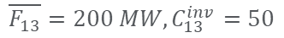
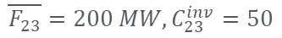
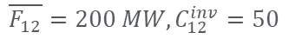
DC-Optimal Power Flow via an ANN
$$\overline{G_{1}}=400 MW, C_{1}^{gen}=20 €/MWh, D_{1}=200$$
$$\overline{F_{12}}=200 MW, C_{12}^{inv}=50$$
$$\overline{G_{2}}=600 MW, C_{2}^{gen}=40 €/MWh,D_{2}=300$$
1
2
$$\overline{F_{13}}=200 MW, C_{13}^{inv}=50$$
$$\overline{F_{23}}=200 MW, C_{23}^{inv}=50$$
3
$$\overline{G_{3}}=200 MW, C_{3}^{gen}=70 €/MWh,D_{3}=400$$

Slide 25
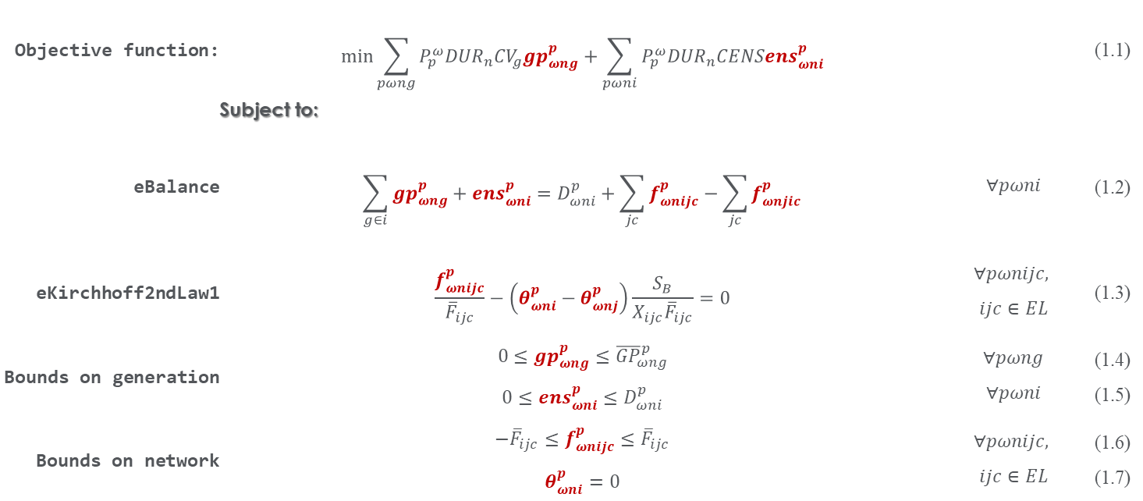
DC-Optimal Power Flow via an ANN
Mathematical Formulation
Objective function: | $$\min_{}{\sum_{pωng}{P_{p}^{ω}{DUR}_{n}{CV}_{g}{gp}_{ωng}^{p}}+\sum_{pωni}{P_{p}^{ω}{DUR}_{n}CENS{ens}_{ωni}^{p}}}$$ |  | (1.1)
 | Subject to:
eBalance | $$\sum_{g∈i}{{gp}_{ωng}^{p}}+{ens}_{ωni}^{p}=D_{ωni}^{p}+\sum_{jc}{f_{ωnijc}^{p}}−\sum_{jc}{f_{ωnjic}^{p}}$$ | $$∀pωni$$ | (1.2)
eKirchhoff2ndLaw1 | $$\frac{f_{ωnijc}^{p}}{{\overline{F}}_{ijc}}−\left(θ_{ωni}^{p}−θ_{ωnj}^{p}\right)\frac{S_{B}}{X_{ijc}{\overline{F}}_{ijc}}=0$$ | $$∀pωnijc,$$ $$ijc∈EL$$ | (1.3)
Bounds on generation | $$0≤{gp}_{ωng}^{p}≤{\overline{GP}}_{ωng}^{p}$$ $$0≤{ens}_{ωni}^{p}≤D_{ωni}^{p}$$ | $$∀pωng$$ $$∀pωni$$ | (1.4) (1.5)
Bounds on network | $$−{\overline{F}}_{ijc}≤f_{ωnijc}^{p}≤{\overline{F}}_{ijc}$$ $$θ_{ωni}^{p}=0$$ | $$∀pωnijc,$$ $$ijc∈EL$$ | (1.6) (1.7)

Slide 26
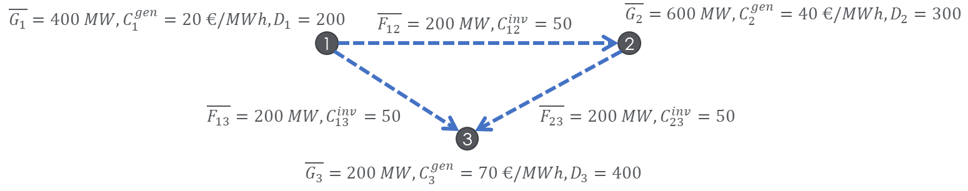
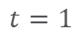
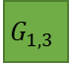
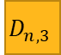

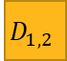
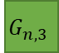
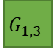
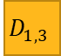
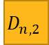

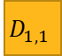
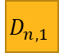
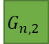
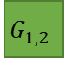
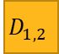

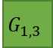
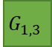




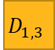
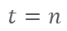
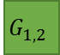
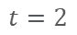

DC-Optimal Power Flow via an ANN
Electricity demand
Wind & solar profiles
Phase 1:
Normalized demand, and generation
Parameters
Outputs
Inputs
Outputs
Bounds
Network features
Continuous
$$t=1$$
$$D_{1,1}$$
$$D_{1,2}$$
$$D_{1,3}$$
$$G_{1,3}$$
$$G_{1,2}$$
$$G_{1,3}$$
Generation costs
NN
Discrete
$$t=2$$
$$D_{1,1}$$
$$D_{1,2}$$
$$D_{1,3}$$
$$G_{1,3}$$
$$G_{1,2}$$
$$G_{1,3}$$
Dataset
$$⋮$$
$$⋮$$
$$⋮$$
$$⋮$$
$$⋮$$
$$⋮$$
Variables
$$D_{n,1}$$
$$D_{n,2}$$
$$D_{n,3}$$
$$G_{n,3}$$
$$G_{n,2}$$
$$G_{n,3}$$
$$t=n$$
Phase 2:
Normalized demand, network features, wind & solar profiles, generation, power flows, and dual variables
Power flows
Power generation
Dual variables

Slide 27
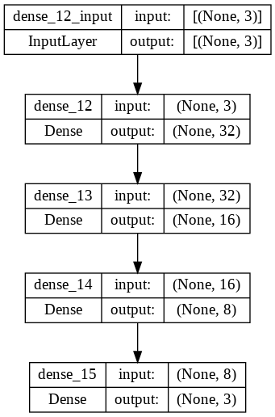
DC-Optimal Power Flow via an ANN
Phase 1:
Normalized demand and generation
NN’s architecture
ToDo:
Tune up the hyperparameters
3
32
16
8
3
Hidden layers

Slide 28
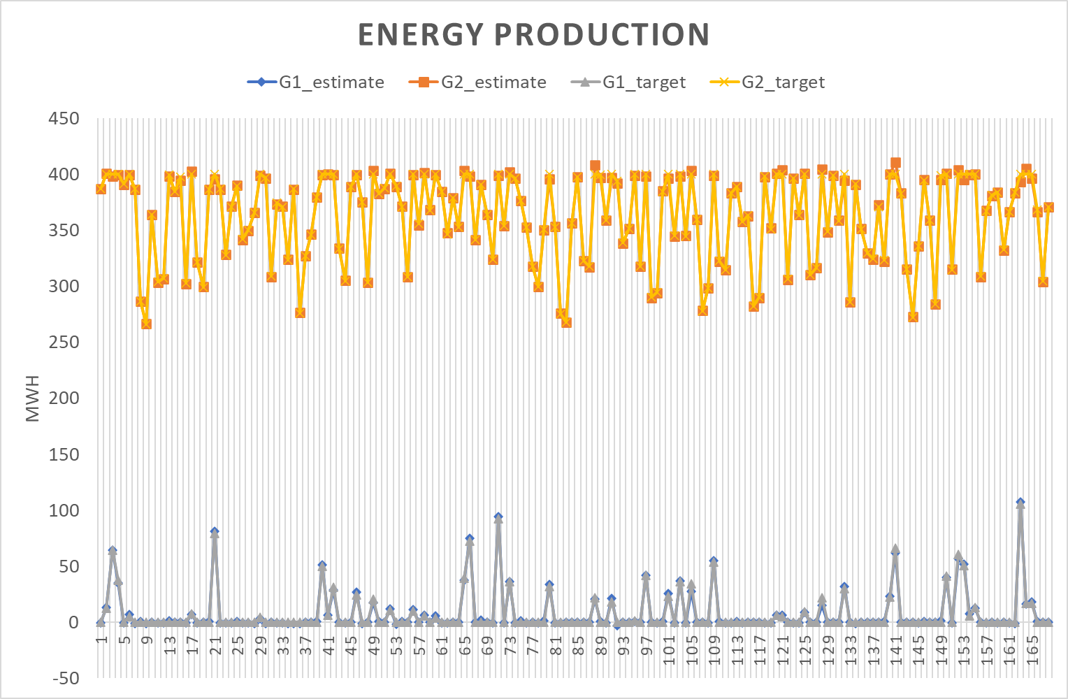
DC-Optimal Power Flow via an ANN
Phase 1:
Normalized demand and generation

Slide 29
Proposal Operational State Aggregation Method Based on Benefits using Learning Algorithms
Relaxed ESOM
Extract features
Clustering Method
Representative periods
ESOM
Current proposal
Potential extension
Greedy ambition
Extract features
Input Data
ANN
Estimator
Total benefit per asset in hourly basis
ANN
Encoder**
Clustering Method
Representative Periods
Relaxed ESOM
Results
*ESOM: Energy System Optimization Model
**Encoder for dimension reduction

Slide 30
Research Plan

Slide 31
Proposal Operational State Aggregation Method Based on Benefits using Learning Algorithms
Current proposal
Potential extension
Input Data
Extract features (Dimension reduction)
Clustering Method
Representative periods
ESOM
Features
(Benefits)
Relaxed ESOM
NN1
Estimation
NN2
Classification
K-means/
K-medoids
3*S*T*N*L^2
*ESOM: Energy System Optimization Model
**Encoder for dimension reduction

Slide 32
Proposal - Part 1: How to get the total benefit?
The PINT and TOOT approaches
Sequence per candidate asset
PINT Sequence
TOOT Sequence
Relaxed ESOM
in hourly basis
Economic Dispatch
in hourly basis
Relaxed ESOM
in hourly basis
Economic Dispatch
in hourly basis
DC-OPF
Estimator
DC-OPF
Estimator
DC-OPF
Estimator
DC-OPF
Estimator
Benefit per asset in hourly basis
Benefit per asset in hourly basis
Total benefit per candidate asset in hourly basis
*ESOM: Energy System Optimization Model
*PINT: Put IN one at a Time
*TOOT: Take Out One at a Time

Slide 33











Proposal - Part 1: How to get the total benefit?
A Neural Network to Estimate the DC-Optimal Power Flow
ANN to Estimate the optimal generation output (${\hat{P}}^{g}$)
$$Z_{1}^{1}$$
$$Z_{2}^{1}$$
$$Z_{k}^{1}$$
$$P^{d}$$
$$Z_{1}^{2}$$
$$Z_{2}^{2}$$
$$Z_{k}^{2}$$
$${\hat{P}}^{g}$$
$$Z_{1}^{N_{k}}$$
$$Z_{2}^{N_{k}}$$
$$Z_{k}^{N_{k}}$$
Input
NN
Output

Slide 34


















Proposal - Part 1: How to get the total benefit?
Physics-Informed Neural Network to Estimate the DC-Optimal Power Flow
PINN to Estimate the DC optimal power flow
Hidden layer ${\hat{P}}^{g}$
$$P^{g}$$
$$Z_{1}^{1}$$
$$Z_{2}^{1}$$
$$Z_{k}^{1}$$
$${\hat{P}}^{g}$$
$$Λ^{g}$$
$${MSE}_{g}$$
$$Z_{1}^{2}$$
$$Z_{2}^{2}$$
$$Z_{k}^{2}$$
$$Z_{1}^{N_{k}}$$
$$Z_{2}^{N_{k}}$$
$$Z_{k}^{N_{k}}$$
$$P^{d}$$
Hidden layer $\hat{θ}$
$$θ$$
PINN
$$Y$$
$$Z_{1}^{1}$$
$$Z_{2}^{1}$$
$$Z_{k}^{1}$$
$$\hat{θ}$$
$$Λ^{θ}$$
$${MSE}_{θ}$$
$$Z_{1}^{2}$$
$$Z_{2}^{2}$$
$$Z_{k}^{2}$$
$$P^{w}$$
$$Z_{1}^{N_{k}}$$
$$Z_{2}^{N_{k}}$$
$$Z_{k}^{N_{k}}$$
Hidden layer ${\hat{L}}^{m}$
$$L^{m}$$
$$Z_{1}^{1}$$
$$Z_{2}^{1}$$
$$Z_{k}^{1}$$
$${\hat{L}}^{m}$$
$$Λ^{L}$$
$${MSE}_{L}$$
$$Z_{1}^{2}$$
$$Z_{2}^{2}$$
$$Z_{k}^{2}$$
$$Z_{1}^{N_{k}}$$
$$Z_{2}^{N_{k}}$$
$$Z_{k}^{N_{k}}$$
Common Layer
$$Λ^{ε}$$
$${MSE}_{ε}$$
RTS24 with 8736 hours
Presolved: 24967488 rows, 29468005 columns, 118591357 nonzeros

Slide 35


Proposal - Part 1: How to get the total benefit?
Physics-Informed Neural Network to Estimate the DC-Optimal Power Flow

Slide 36
Research Plan
Stage 0: Understanding neural networks
Develop a neural
Literature Review:
Review of learning-assisted approaches
Review of learning-assisted power system optimization
Review of neural networks
Using Python and PyTorch (Ruben’s suggestion), steps:
First, install PyTorch. (You can follow the official PyTorch installation guide for this).
Once you have installed PyTorch, you can validate the installation by running a small program in PyTorch as a non-root user 1. This will ensure that PyTorch has been installed correctly.
After validating the installation of PyTorch, you can start using it for image classification . You can also learn about tensors, datasets and dataloaders, transforms, building models, automatic differentiation, optimization loop, saving/loading and using models from the official PyTorch tutorials.
Step 2:
Design my own IA-based method.

Slide 37

Proposal: Part 2
RL schemes for the control and decision-making in power systems (figure taken from [1]).
[1] Chen, Xin, et al. "Reinforcement learning for selective key applications in power systems: Recent advances and future challenges." IEEE Transactions on Smart Grid (2022).

Slide 38
A Learning-Assisted Optimization Model for Power System Planning
Motivation
Traditional solvers are slow - fast approximate solvers needed
Method
Experiments
Application
Economic Dispatch
Expansion planning problem with continuous variables

